Slide 1

Customer Retention Case Study
Presented by – Safiya Firdose Khan

Slide 2
AGENDA
Introduction
Problem Statement
Objective
Exploratory Data Analysis
Data Visualization
Findings of Data Analysis
Conclusion

Slide 3
Introduction
What is Customer Retention?
Customer retention refers to a company’s ability to turn customers into repeat buyers and prevent them from switching to a competitor. It indicates whether your product and the quality of your service please your existing customers. It is also the lifeblood of most subscription-based companies and service providers.
Customer retention strategies are the processes and initiatives businesses put in place to build customer loyalty and improve customer lifetime value.

Slide 4
Customer retention is different from customer acquisition or lead generation. It focuses on customers who have already signed up for a service or purchased a product from you. But retaining customers is about more than just transactions—it is about relationships. Research shows that customers view their relationships with brands similarly to their relationships with friends. Customers like brands that are reliable, authentic and aware of what matters to them. Focus on buyer relationships with your existing customers to boost their brand loyalty. These shoppers will continue to choose your brand even when presented with other options. With this loyal base, your brand will be more likely to weather explosive markets.

Slide 5
Why is customer retention important?
Keeping your current customers happy is generally more cost-effective than acquiring first-time customers. According to the Harvard Business Review, acquiring a new customer can be five to 25 times more expensive than holding on to an existing one.
Acquiring a new customer can be five to 25 times more expensive than holding on to an existing one.

Slide 6
You do not need to spend big on marketing, advertising or sales outreach. It is easier to turn existing customers into repeating ones, since they already trust your brand from previous purchases. New customers, however, often require more convincing when it comes to that initial sale. Customer loyalty will not just give you repeat business. Loyal customers are more likely to give free recommendations to their colleagues, friends and family. Creating that cycle of retained customers and viral marketing is one way your company can cultivate customer loyalty for long-term success.

Slide 7
Customer retention benefits
Cost savings: Customer retention is generally more cost-effective than acquiring first-time customers
Positive word of mouth marketing: Loyal customers are more likely to tell their friends and family about your brand
A better bottom line: Increasing retention rates by just 5 percent can increase revenue by 25 percent to 95 percent

Slide 8
How do you measure your customer retention rate?
The customer retention rate is the percentage of previous customers who remained loyal to your business over a period of time. To calculate it, pick a period of time you want to measure and then identify the following:
Number of customers at the start of a given time period (S)
Number of customers at the end of that period (E)
Number of new customers added over the duration of that period (N)
Then, you can calculate your customer retention rate (X) with the following formula:
Customer retention formula
((E – N) / S) * 100 = X

Slide 9
6 strategies to improve customer retention
1. Respond to customer support queries quickly
2. Use context to deliver personalised support interactions
3. Simplify customer service workflows
4. Offer omnichannel support to reach customers where they are
5. Consistently gather customer feedback
6. Incentivise loyalty

Slide 10
Improving customer retention means improving the customer experience. If you make interactions more convenient, personal and rewarding for your customers, they are likely to be more loyal in return.

Slide 11
Use Case Diagram

Slide 12
Objective
* The objective is to apply the analytical skills to provide findings and conclusion that would help to predict customer retention for a E-Retail company using their data on users provided over period of time.
* Using the model I was tasked with determining which features were most influential in loss of valuable customer and then making a plan for how the company could use this information to increase customer retention.

Slide 13
Details of the Dataset:
The dataset contains two excel sheets, one is detailed datasheet and the other one is encoded datasheet. I have used detailed datasheet for the processing.
The dataset consists of 269 rows and 71 columns, which is comprised of categorical columns. All the features contain object data type, except the feature Pin code (integer data type).
Firstly, I have imported the necessary libraries and dataset.
I checked the names of the columns and found them to be too lengthy, and hence renamed them.
Then, I checked the type of the dataframe and the detailed info about the dataframe.

Slide 14
* I also checked the null values present in the dataset and found out that no null values were present in our dataset.
* I also checked the unique values present in the dataset by using the nunique method.
* Then, I checked the datatypes of the columns, and found out that all the columns are of object datatype, except the column ‘Pin_Code’. So, I converted the datatype of column ‘Pin_Code’ from integer datatype to object datatype. I used a for loop to take a look at all the unique values present in the categorical columns covering the number of rows in the dataset.

Slide 15
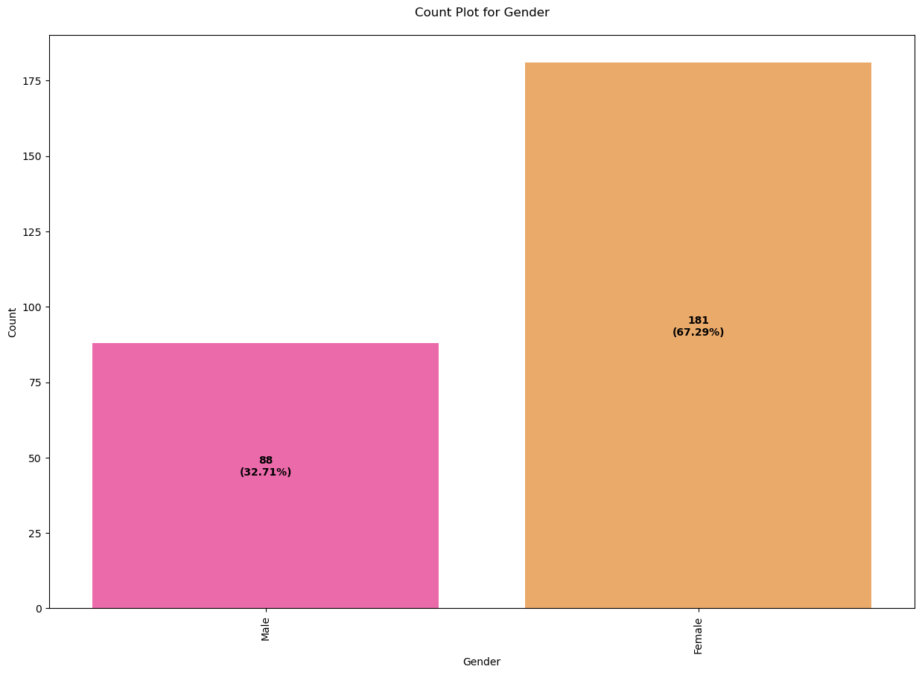
Data Visualization Univariate Analysis:

Slide 16
* With the help of count plots, I was able to get the total number of rows covered by each unique categorical value present in all the columns of our dataset.
* I ensured that, along with the total number of rows, the percentage of data coverage is made visible too.

Slide 17
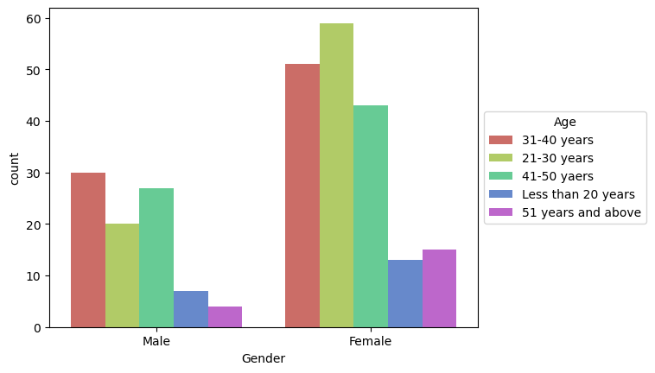
Bivariate Analysis:
As we can see, majority of the female customers who shop online are in the age group of 21-30 years, followed by 31-40 years.
As we can see, majority of the male customers who shop online are in the age group of 31-40 years, followed by 41-50 years.

Slide 18
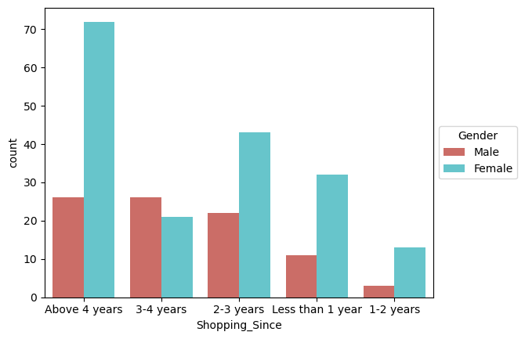
As we can see, majority of the female customers have been shopping online for
more than 4 years. Also, a considerable amount of female customers have been
shopping online since 2-3 years.
As we can see, male customers who have been shopping online for more than 4 years is considerably low, as compared to female customers. Thus, we can conclude that, a vast majority of customers who shop online are female.

Slide 19
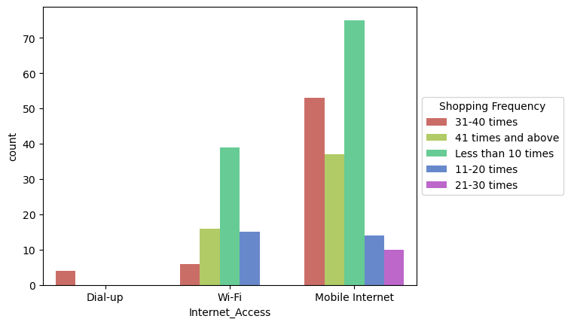
As we can see, majority of the customers shop online less than 10 times in a year
by using Mobile Internet, followed by customers who shop online 31-40 times in a
year.
Few customers also shop online less than 10 times in a year by using Wi-Fi.

Slide 20
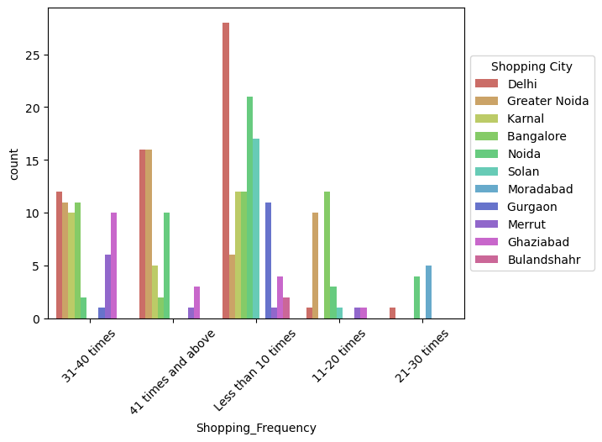
As we can see, majority of the customers who shop online less than 10 times in a
year are from Delhi.

Slide 21
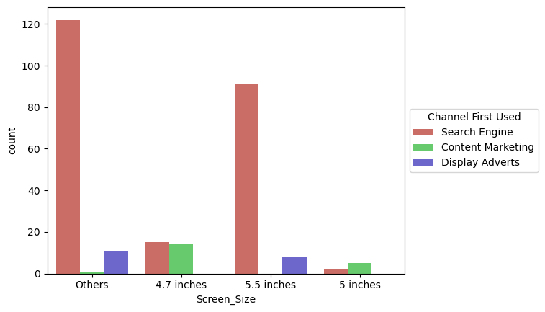
As we can see, majority of the customers whose Screen Size was other than 4.7, 5 and 5.5 inches used Search Engine to arrive at their favorite online store for the first time.
Also, the customers whose Screen Size was 5.5 inches also used Search Engine to arrive at their favorite online store for the first time.

Slide 22
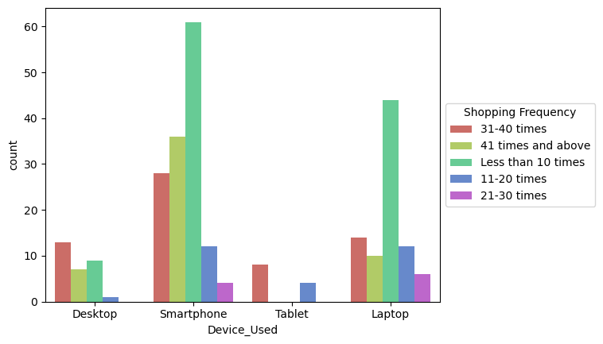
As we can see, majority of the customers used Smartphones to make an online purchase less than 10 times in the past 1 year.

Slide 23
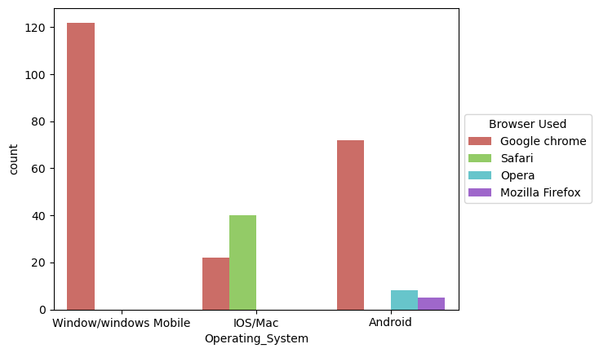
As we can see, majority of the customers having Windows Operating System in
their device used Google chrome to access the ecommerce shopping websites.
Also, a considerable amount of customers having android used Google Chrome
to access the ecommerce shopping websites.
There are also a few customers having IOS/Mac operating system who used
Safari, followed by Google Chrome to access the website.

Slide 24
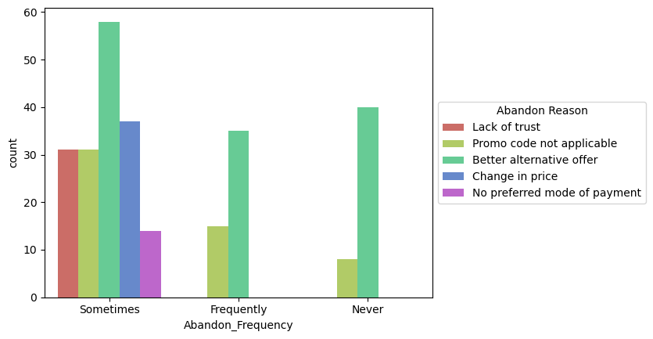
As we can see, majority of the customers sometimes abandoned their shopping cart because they found a better alternative offer, followed by customers who abandoned their shopping cart due to change in price.

Slide 25
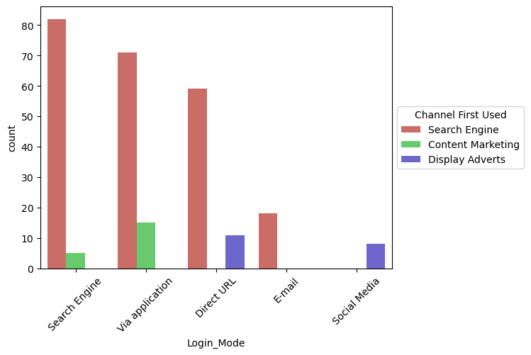
As we can see, majority of the customers used Search Engine to arrive at their favorite online store for the first time.

Slide 26
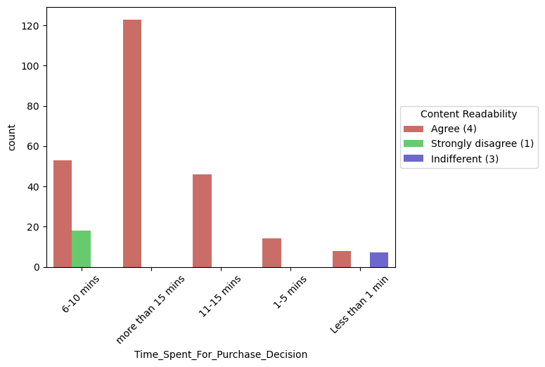
As we can see, majority of the customers who spent more than 15 mins for making
a purchase decision, agreed that the content on the website must be easy to
read and understand.

Slide 27
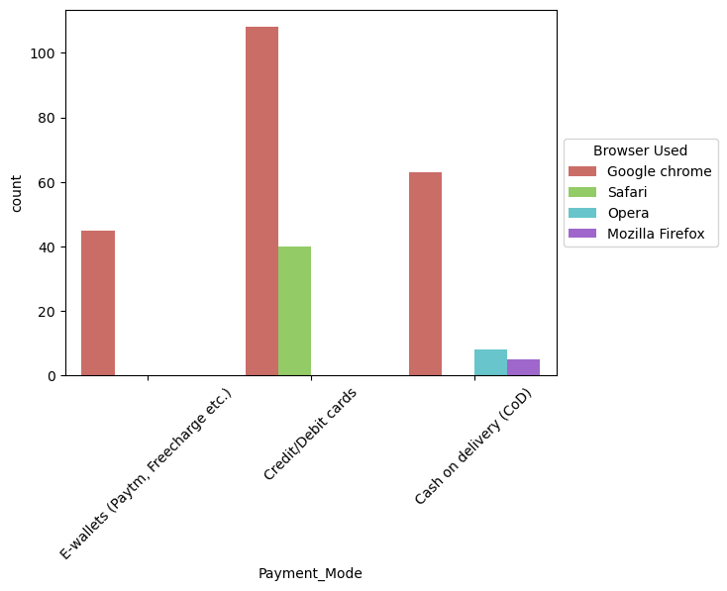
As we can see, majority of the customers who used Google chrome, made a payment for their online purchase by using Credit/Debit cards.

Slide 28
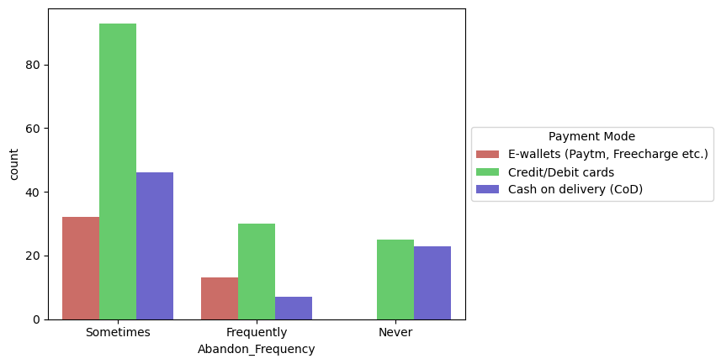
As we can see, majority of the customers sometimes abandon their shopping cart, when the mode of payment used is Credit/Debit cards.

Slide 29
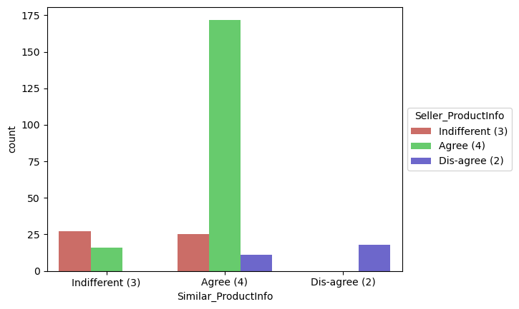
As we can see, majority of the customers agreed that the information on similar product to the one highlighted is important for product comparison. The customers not only want a complete information about the products, but also want a complete information on listed seller.

Slide 30
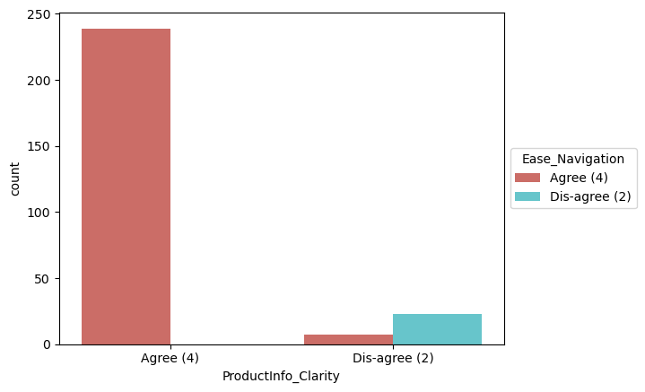
As we can see, majority of the customers agreed that they should be able to navigate the website easily and all the relevant information on listed products must be stated clearly. If these conditions are met, then the customers are more
likely to make an online purchase.

Slide 31
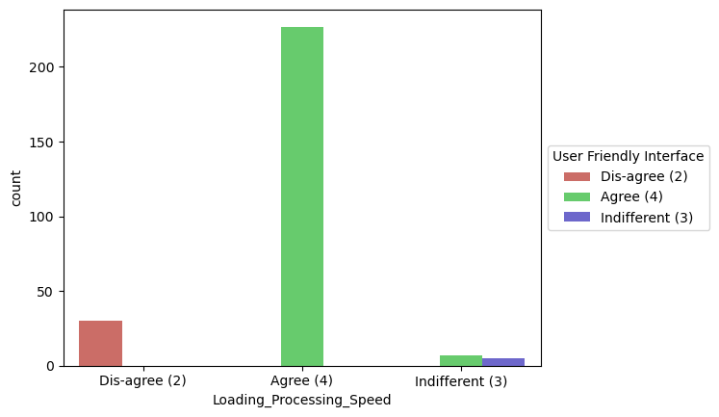
As we can see, majority of the customers are of the opinion that the loading and processing speed should be high and also the interface of the website should be user friendly. If these requirements are satisfied, then the customers are obviously
attracted towards the ecommerce websites, which would results in the betterment of sales.

Slide 32
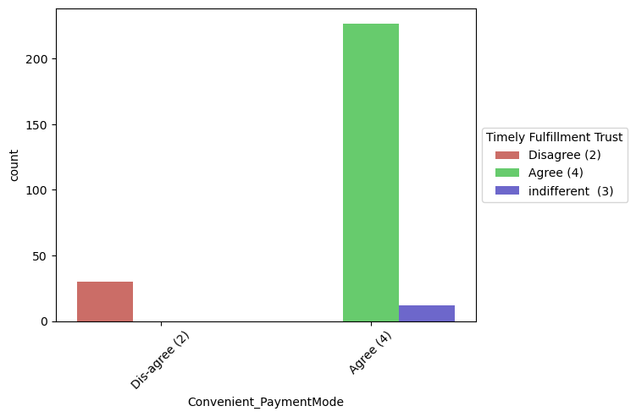
As we can see, majority of the customers are of the opinion that the ecommerce websites should provide convenient payment methods, and majority of the customers trust that the online retail store will fulfill its part of the transaction at the stipulated time.

Slide 33
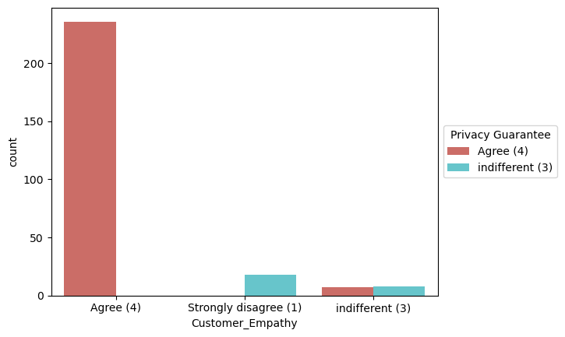
As we can see, majority of the customers desire Empathy from the ecommerce websites, and they also want that their privacy is guaranteed. Hence, the ecommerce websites should be able to resolve all the queries of the customers and they have to assure the customers, that their credentials are secured and confidential. If the ecommerce websites guarantee the privacy of the customers, then the customers feel safe to shop online and are likely to shop more, which will enhance the sales.

Slide 34
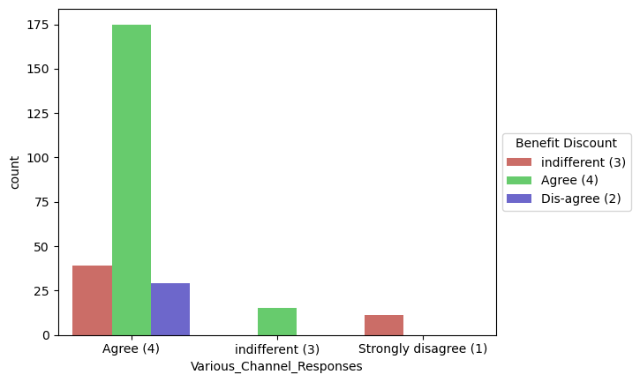
As we can see, majority of the customers agree that shopping online gives them monetary benefits and discounts. Hence, the ecommerce websites should give discounts and coupon codes to the customers. Also, majority of the customers agree that the ecommerce websites should be responsive to their queries, and
they should be available on several communication channels (email, online rep, twitter, phone etc). thus, in order to improve the sales, the ecommerce websites should ask the feedback regarding their services, ratings of the products, reviews etc.

Slide 35
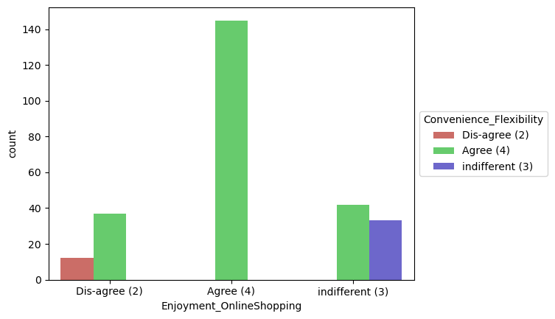
As we can see, majority of the customers agree that shopping online is convenient and flexible. If the customers feel that shopping online is convenient and flexible, then it is obvious that they would enjoy the whole shopping experience.

Slide 36
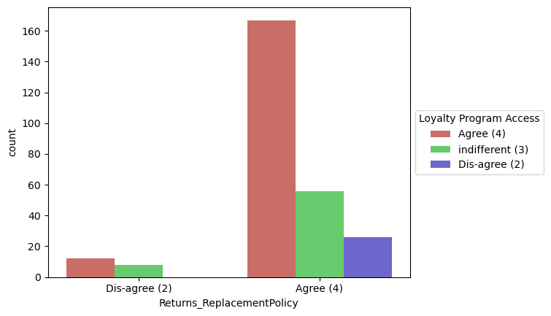
As we can see, majority of the customers agreed that return and replacement policy of the ecommerce websites is important for making a purchase decision. If the products are non-returnable, then the customers feel skeptical about ordering the products, as they would not be able to return the products, in case they don't like it. So, in order to improve the sales, the ecommerce websites should provide easy return and replacement policy. Also, majority of the customers are of the opinion that they should be able to gain access to loyalty programs. If an access to loyalty programs is provided, then the customers tend to shop more. Thus, the ecommerce websites should provide access to loyalty programs, which inturn would result in improvement of sales.

Slide 37
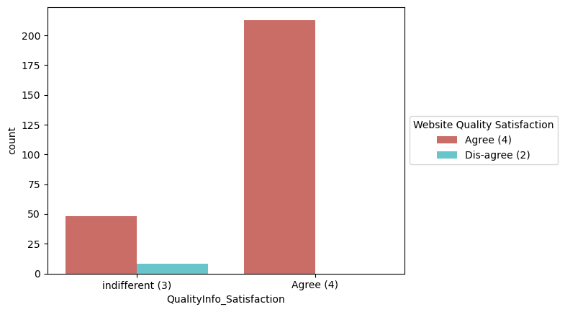
As we can see, majority of the customers agreed that displaying quality information on the website improves satisfaction of customers. If complete information about the quality of the products is provided, then the customers tend to feel that the website or application is good to shop from. This would result in the customers ending up making purchases on the ecommerce website, as they feel satisfied while shopping from a good quality website or application.

Slide 38
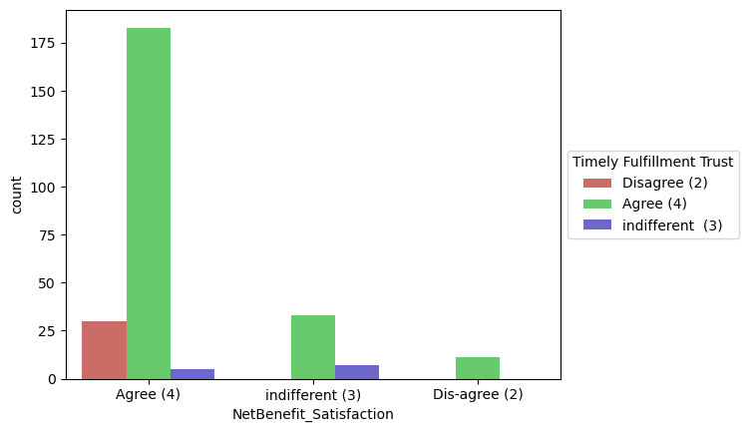
As we can see, majority of the customers agreed that Net Benefit derived from shopping online can lead to users satisfaction. The customers should feel that they are getting benefitted by shopping online. Thus, the ecommerce websites should attract the customers by giving them huge discounts and coupon codes. Also, note that majority of the customers agree that there should be a trust that the online retail store will fulfill its part of the transaction at the stipulated time. thus, the ecommerce websites should work with their delivery partners, and make sure that the orders are delivered on time.

Slide 39
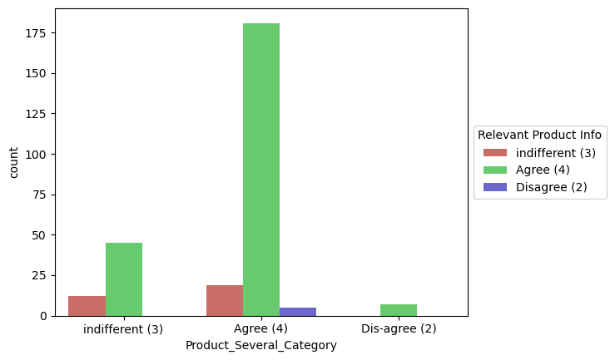
As we can see, the customers agree that the ecommerce websites should offer them a wide variety of products across several categories, so that the customers can have many products to choose from. Also, majority of the customers agree that there should be provision of complete and relevant product information. Both these factors can help the ecommerce websites in improving their business.

Slide 40
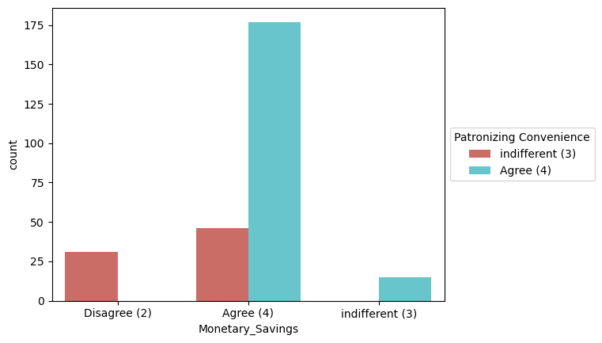
As we can see, majority of the customers agree that it should be convenient to patronize the online retailer, and there should be monetary savings involved. In this digital and competitive world, everyone wants to save money. thus, the ecommerce companies need to know that the best way to sell online is to make the consumer feel that he is saving money doing so. And not just feel, online shopping should result in a lot of saving for the consumer. This saving would automatically get converted into trust and brand equity for the seller. To do this the online companies should offer the best deals and bargains to the consumer through social platforms. If the retailers give some discounted prices then the customers can make money savings and they tend to purchase in the same websites regularly. Convenience is the important thing for ecommerce and most of the customers agreed with it.

Slide 41
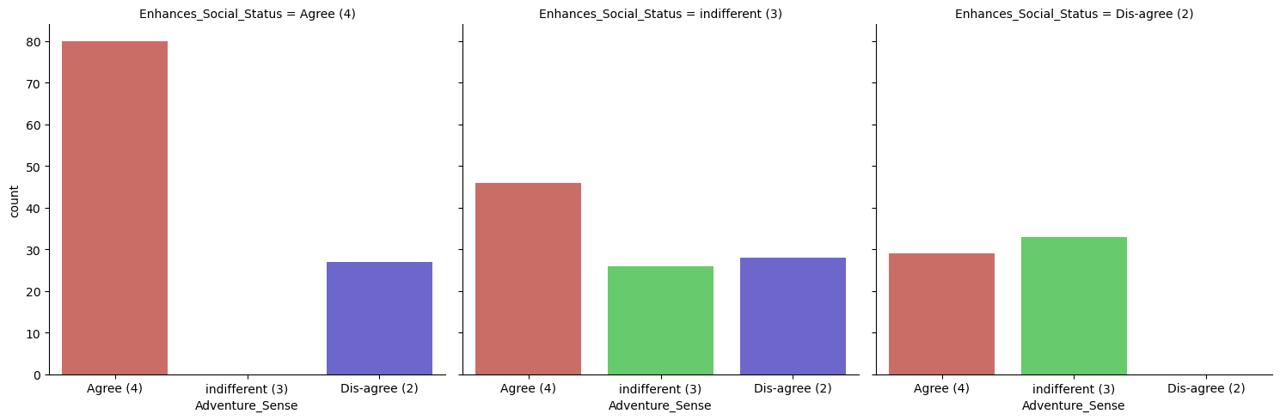
As we can see, majority of the customers agree that shopping on their favorite website gives them a sense of adventure, and also enhances their social status.

Slide 42
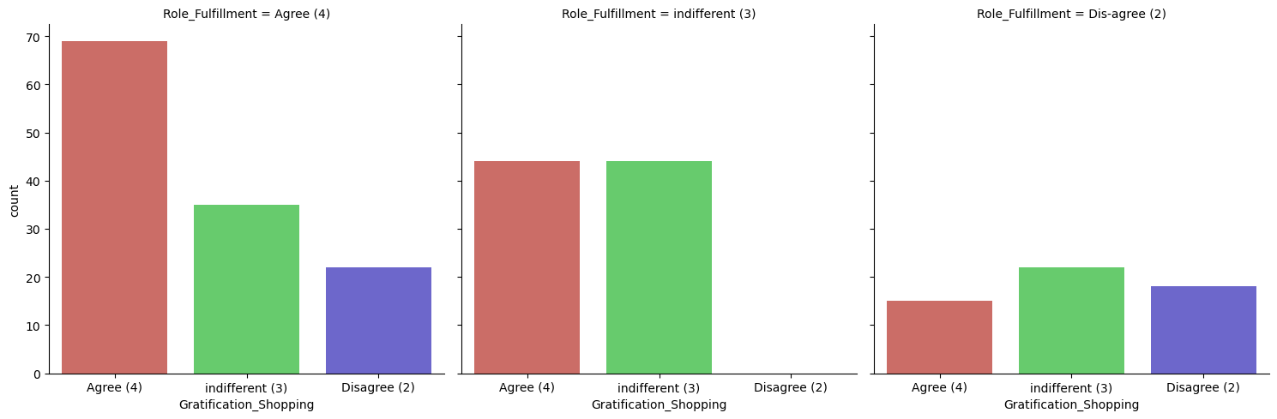
As we can see, majority of the customers agree that shopping on their favorite website helps them fulfill certain roles, and they feel gratified shopping on their favorite website.

Slide 43
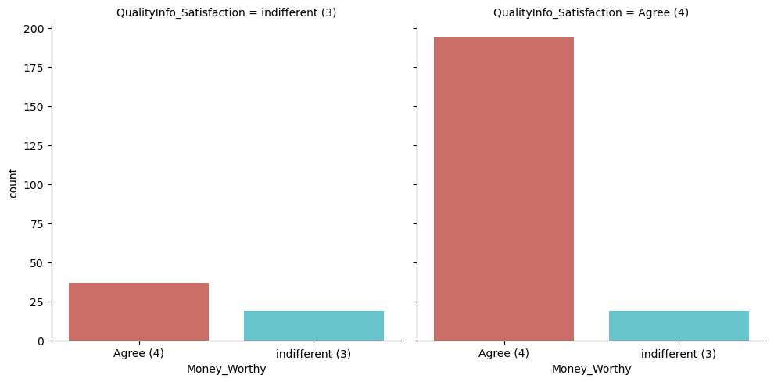
As we can see, majority of the customers agree that quality information on the website should be displayed, which in turn results in improvement of satisfaction of the customers. If the customers are satisfied with the information about the quality of the products, then they tend to feel that they are getting value for money spent.

Slide 44
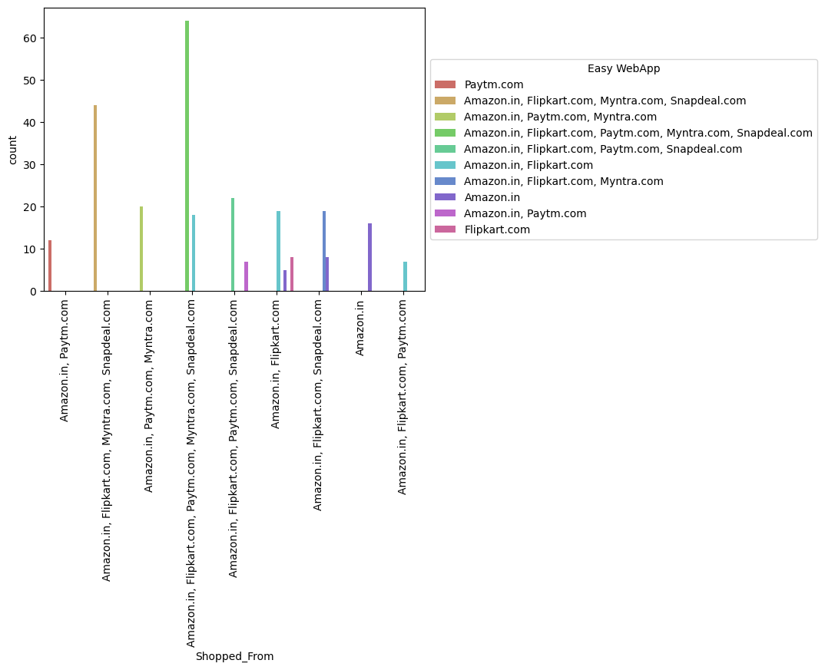
As we can see, majority of the customers feel that Amazon.in, Flipart.com, Paytm.com, Myntra.com and Snapdeal.com have an easy to use website and application. Hence, they tend to shop from these ecommerce websites.

Slide 45
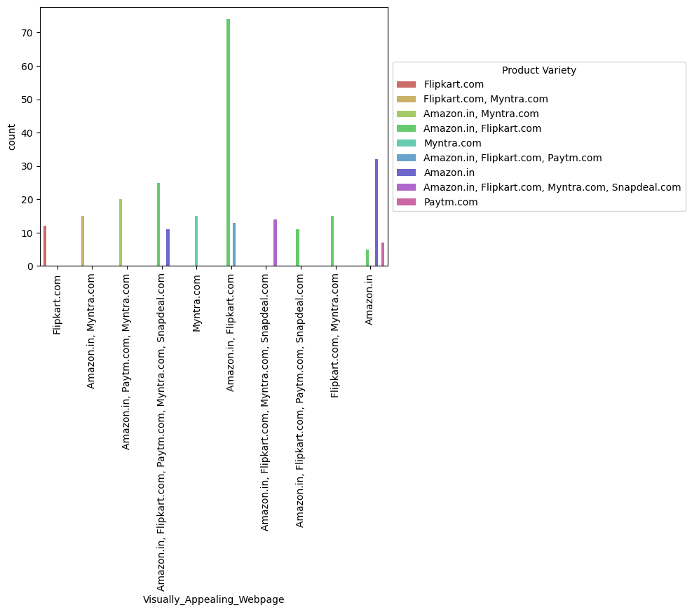
As we can see, majority of the customers feel that Amaon.in and Flipkart.com have a visually appealing webpage, and also they have a wide variety of products on offer.

Slide 46
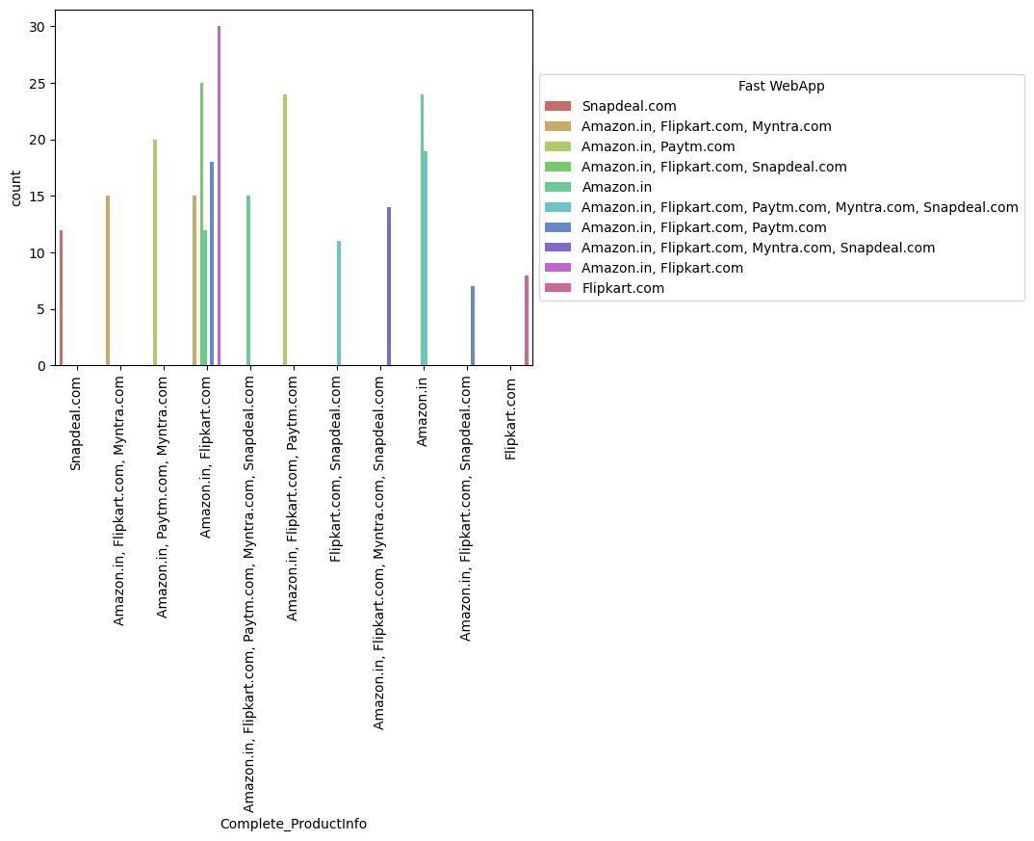
As we can see, customers feel that Amazon.in and Flipkart.com provide a complete information about the listed products, and they also feel that Amazon.in and Flipkart.com have the fastest website and application.

Slide 47
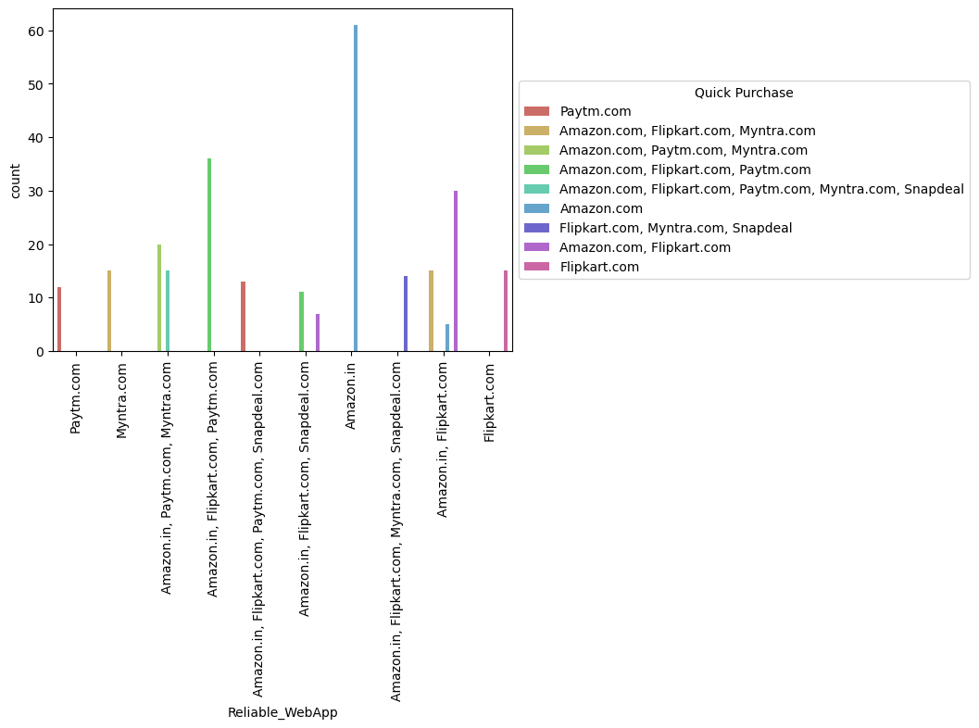
As we can see, majority of the customers feel that amazon.in has the most reliable website and application. As the customers feel that Amazon.in is reliable, they tend to make a quick purchase.

Slide 48
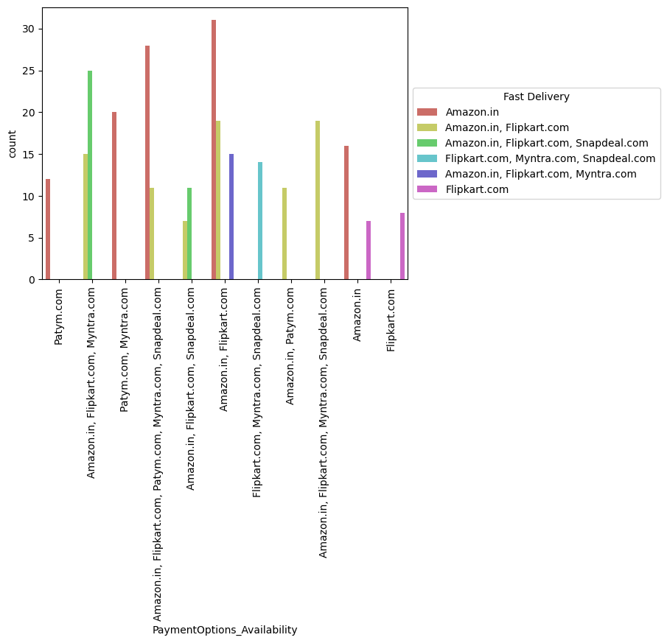
As we can see, Amazon.in offers availability of several payment options, due to which the customers find it convenient to shop on Amazon.in. Also, Amazon.in delivers the products very fast.

Slide 49
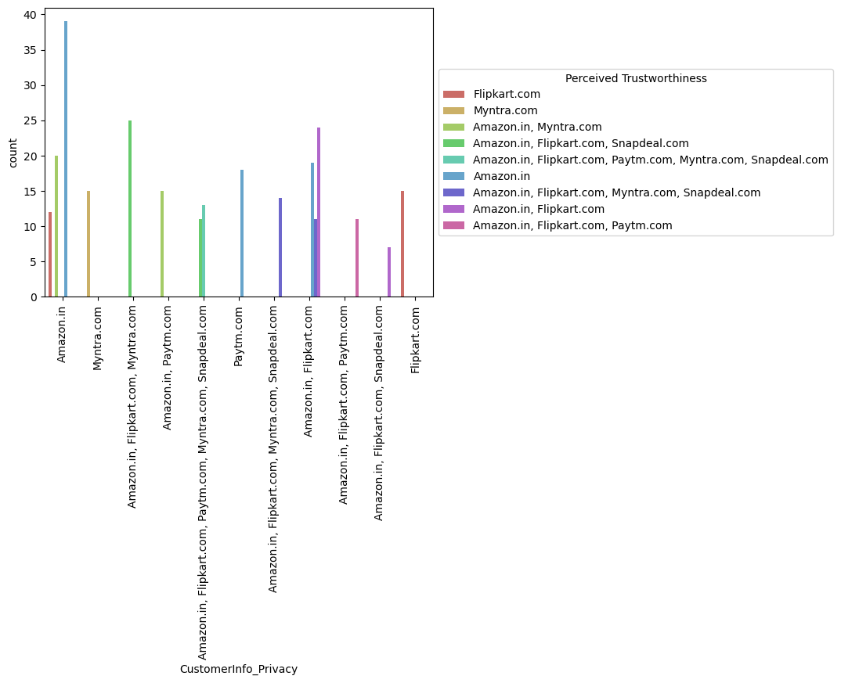
As we can see, Amazon.in provides the best privacy of customers information, and hence the customers trust Amazon.in.

Slide 50
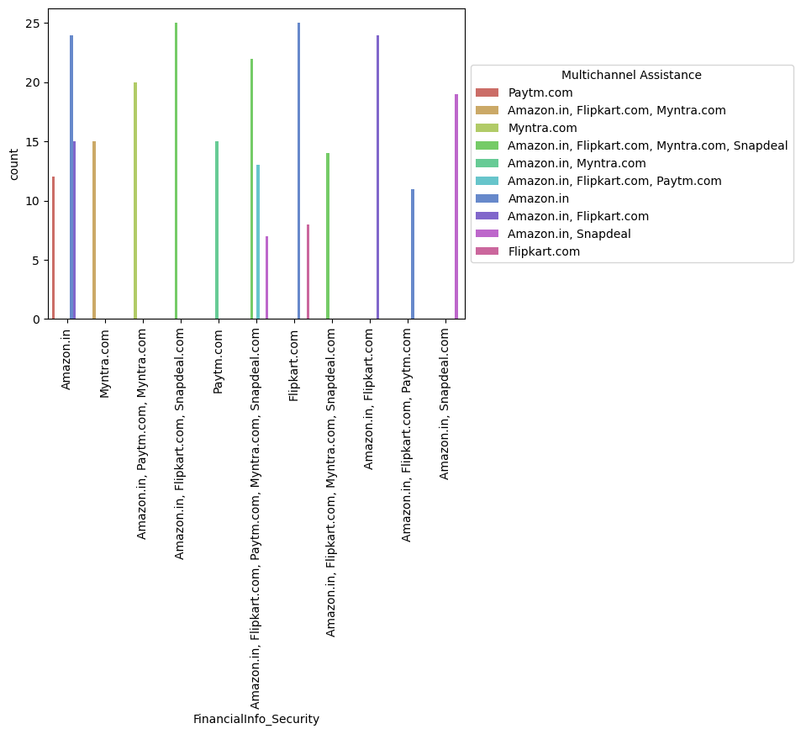
As we can see, majority of the customers feel that Amazon.in, Flipkart.com and Snapdeal.com provide security of customer financial information. Also, Amazon.in, Flipkart.com and Snapdeal.com provide online assistance through multichannel.

Slide 51
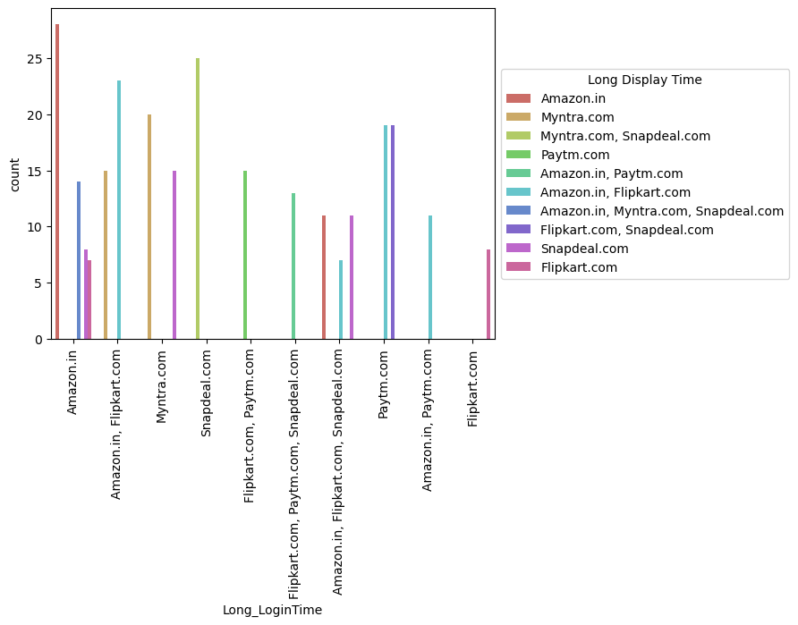
As we can see, during the promotion and sales period, the traffic on the ecommerce websites increases tremendously, especially on Amazon.in. Due to this, the login time and display time for Amazon.in is higher.
On the second position, there is Snapdeal.com with longer login and display time.

Slide 52
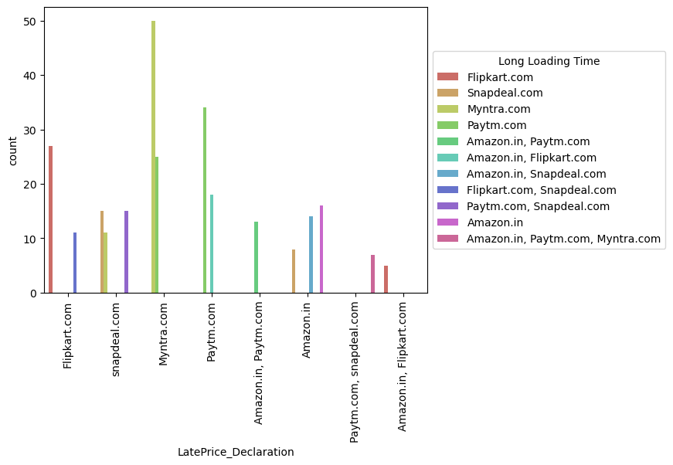
Myntra.com declares the prices late during the promotion and sales period, due to which the traffic on the website increases tremendously during the promotion and sales period, which ultimately leads to longer login time. The same issues are faced while using Paytm.com, although to a lesser extent. These factors are a major drawback from the business perspective, and should be taken care of by the ecommerce websites.

Slide 53
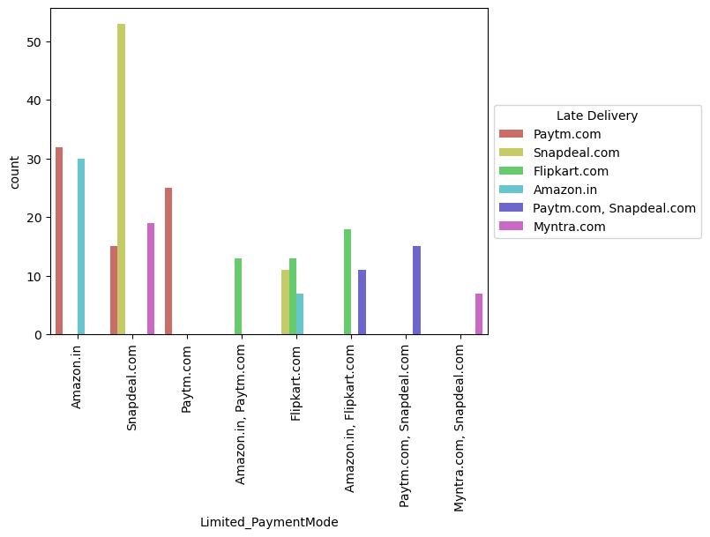
As we can see, Snapdeal.com has limited payment modes and also delivers the products late, followed by paytm.com.

Slide 54
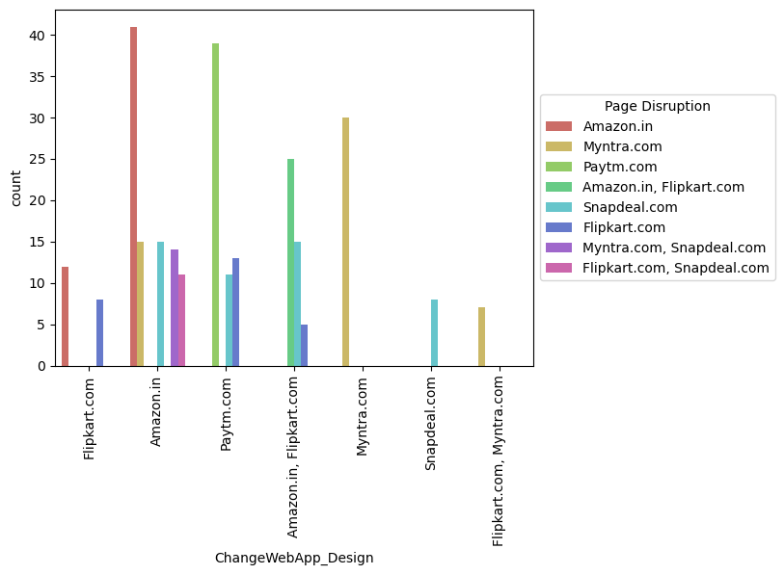
As we can see, majority of the customers want a change in website or Application design, as they are facing frequent page disruption when moving from one page to another.

Slide 55
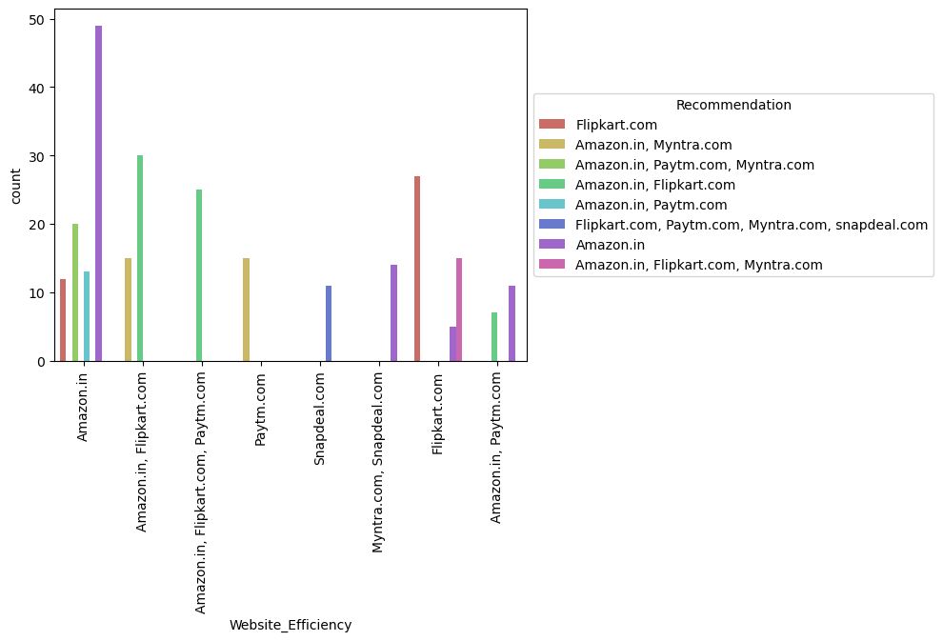
As we can see, majority of the customers find Amazon.in to be an effiicient website for online shopping, and hence would recommend it to their friends.

Slide 56

Findings of Data Analysis:
1. Amazon.in
To be improved:
During promotions, try to give a disturbance free shopping experience to customers.
Give more payment options to customers.
Try to give price early during promotion.
Reduce the delivery time of the products.
Positive feedback summary:
Convenient to use and also a good website for shopping.
Fast delivery of products.
Availability of complete information of the products.
Presence of online assistance through multi-channels.
Reliable website or app, perceived trustworthiness.

Slide 57

2. Flipkart.com
To be improved:
During promotions, try to give a disturbance free shopping experience to customers.
Give more payment options to customers.
Try to give the price early during promotion.
Reduce the delivery time of the products.
Flipkart and Amazon almost share the same feedbacks with varying percentages as the only difference.
Positive feedback summary:
Convenient to use and also a good website for shopping.
Fast delivery of products.
Availability of complete information of the products.
Presence of online assistance through multi-channels.
Reliable website or app, perceived trustworthiness.
Wild variety of products to offer.

Slide 58

3. Myntra.com
To be improved:
During promotions, try to give a disturbance free shopping experience to customers.
Try to give the price early during promotions.
Reduce the delivery time of the products during promotions.
Positive feedback summary:
Convenient to use and also a good website.
Availability of several payment options.
Faster products delivery.
Complete information of products available.
Reliable website or app, perceived trustworthiness.

Slide 59

4. Paytm.com
To be improved:
Reduce the delivery time of the products during promotions.
Try to give the price early during promotion.
During promotions, try to give a disturbance free shopping experience to customers.
Late declaration of price and discounts.
Frequent disturbance is occurring while moving from one page to another.
Positive feedback summary
Convenient to use and a good website.
Quickness to complete a purchase.
About 64% of the customers feel that either web or app is reliable.
Around 20% of the customers believe that Paytm has a wild variety of products on offer.

Slide 60

5. Snapdeal.com
To be improved:
Reduce the delivery time of the products during promotions.
Try to give the price early during promotion.
During promotions, try to give a disturbance free shopping experience to customers.
Late declaration of price and discounts.
No one has expressed to recommend Snapdeal to a contact as it has the most negative feedbacks among all other websites.
Positive feedback summary:
Convenient to use.
54% of the customers are happy about the availability of financial information security.

Slide 61
Conclusion:
The results of this study suggest following outputs which might be useful for E-commerce websites to extend their business
1. The cost of the product, the reliability of the E-commerce company and the return policies all play an equally important role in deciding the buying behaviour of online customers. The cost is an important factor as it was the basic criteria used by online retailers to attract customers. The reliability of the E-commerce company is also important, as it is even required in offline retail. It is important because customers are paying online, so they need to be sure of security of the online transaction. The return policies are important because in online retail customer does not get to feel the product. Thus, he wants to be sure that it will be possible to return the product if he does not like it in real. Whereas, the logistics factor, which included Cash on delivery option, One day delivery and the quality of packaging plays a secondary role in this process though these are Must-be-quality. This is so because these all does not interfere with the real product and people believe that this is the basic value that E-commerce websites provide.

Slide 62
2. All the websites were not equally preferred by online customers. Amazon was the most preferred followed by Flipkart. This can be explained easily by previous result that we got. These two companies are
most trusted in the industry and hence, have a huge reliability. Also, the sellers listed on these websites are generally from Tier 1 cities as compared to Snapdeal and PayTM which have more sellers from tier 2 and 3 cities. Also, these websites have the most lenient return policies as compared to others and also the time required to process a return is low for these.

Slide 63


